Slide 1
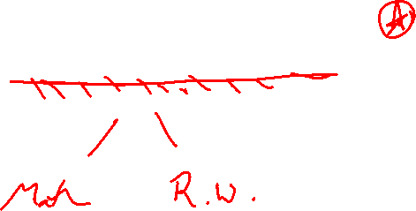
Chapter 4 Applications of Differentiation
Introduction

Slide 2
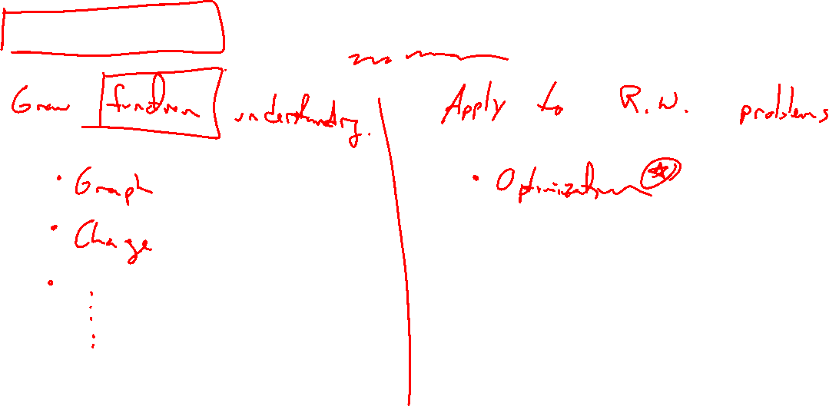
Usefulness of the derivative
Notes:
Long list of uses, most seem more mathy than applicable:
https://en.wikipedia.org/wiki/Differential_calculus#Applications_of_derivatives
https://en.wikipedia.org/wiki/Mathematical_optimization

Slide 3
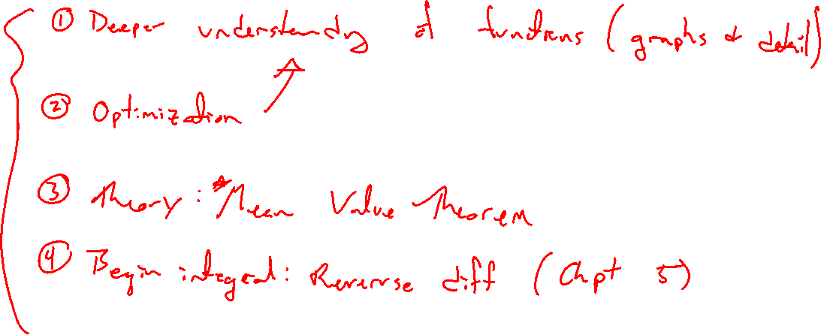
Outline of Chapter
Notes:
Deeper function understanding: Graphing with detail
Optimization: Max and min values
Theory: MVT
Beginnings: Reversing differentiation

